Slide 1
Portal Technologies
Focus Area: Foundation
Notes:
KEY
Provide participants with basic module information
HOW
Explain we are going to cover the technologies module
TIME
1 min

Slide 2
Training Overview
Group Workshop
Back-end
Front-end
Services
Integration
Content
Services
Advanced
Security
Widget Development
Widget
Extras
Targeting
Publishing
Container
Development
Foundation
Portal Essentials
Portal Technologies
Portal Tools
Portal APIs
Notes:
KEY
Module overview
HOW
Give an overview about the new module
TIME
1 min

Slide 3
Objectives
Get to know the technologies Portal is using under the hood
Get to know how to install and run a Portal server in your development environment
Become familiar with the development setup’s directories and files
Notes:
KEY
Module objectives
HOW
Explain each objective
TIME
1 min

Slide 4
Languages and Standards
Portal Technologies

Slide 5
Portal Skillsets
Node
Bower
SASS
Google
Closure
JSP
Twitter
Bootstrap
HTML
Spring
CSS
Java
Javascript
JSON
Camel
Angular.js
XSLT
XML
jQuery
Solr
Require.js
D3.js
Maven
Android
Ant
iOS
Jenkins
Notes:
KEY
Show the CXP technology stack
HOW
Fade in schedule:
Core technologies
Commonly used standards and languages
Other JS Frameworks
Not restricted to js for widgets. Anything that can talk to the rest API
Other build tools, mainly maven
Other template languages
Other integration scenarios
TIME
5 min

Slide 6



Portal Skillsets
Client side developer
BROWSER
GUI Customization
Widgets
API
Widgets
API
Widgets
API
Portal Client API
SERVER
Existing Services / Systems / Applications
Portal Services API
ECM / WCM
Biz. Web Services
Security Service
http / Java
Personalization Service
Single Sign On
ESB / BPM
Server
Customization
CRM
Traditional Apps
Integration Service
….
…
Content Service
Presentation Service
Existing applications developer
Java backend developer
Notes:
KEY
Present the roles involved in the CXP development and customization
HOW
Front-end developers: deals with front end issues
developing widgets, containers
using APIs
UX optimization
Backend developers: in charge of the server side
services development
Integration
security
Existing application developers: in charge of maintaining legacy / 3rd party applications
TIME
3 min

Slide 7
Technologies Overview
Portal Technologies

Slide 8
Java
Portal is an Enterprise Java Application
Makes heavy use of Spring under the hood
Key area’s of Spring
Spring IOC
Spring MVC
Spring Security
Notes:
KEY
Spring as a key API
HOW
Mentioned in PC1 module
Spring IOC : Inversion of Control (aka Dependency injection)
TIME
2 min

Slide 9
Javascript
Portal client can render the model client side with JS
Widget behavior is usually written with JS
jQuery is shipped with Portal as a Portal Client dependency
But not a widget dependency
Notes:
KEY
Explain the role of the Javascript language in CXP
HOW
Portal Client is useful to inspect widget’s model, rendering the model client-side.
TIME
1 min

Slide 10
XML
Very ubiquitous throughout Portal
Most configuration
Web app
Spring
Maven
REST data interchange format
Notes:
KEY
Explain the role of XML in CXP
HOW
Explain that several descriptors use XML as a standard format, as well as for communication (e.g. REST services)
TIME
1 min

Slide 11
Apache MAVEN
Software tool for software project management and build automation.
Based on the concept of a project object model (POM), Maven can manage a project's build, reporting and documentation from a central piece of information.
Convention over configuration
/src/main/java
/src/main/webapp
/src/test
Notes:
KEY
Give a brief overview of Maven
HOW
Provide Maven basic information for those who may not already be familiar with it. If the participants are familiar with Maven details of this level can be skipped.
Software tool made for build automation. Built around the concept of the Project Object Model (POM.xml), specifying all the aspects of the project. MVN assumes that certain type of files will be found in certain folders (‘convention’)
TIME
2 min

Slide 12
Intro to MAVEN
Archetype is a Maven project templating toolkit
An original pattern or model from which all other things of the same kind are made.
Artifacts
An artifact is a file, (usually a JAR), that gets deployed to a Maven repository.
Each artifact has a group ID (usually a reversed domain name, like com.example.foo), an artifact ID (just a name), and a version string.
A project's dependencies are specified as artifacts.
Artifacts are stored in a repository
Central repository
Local repository
Notes:
KEY
Basic information about artifacts and archetypes
HOW
Archetypes describe a project in every aspect (dependencies, build cycles, etc…)
Artifacts are deployable files (usually .jar)
Central repo = remote
Local repo = on your computer
TIME
1 min

Slide 13
Intro to MAVEN
The Project Object Model (pom.xml)
Project meta data
Dependencies
Build lifecycle
Plugins
Notes:
KEY
POM definition
HOW
Maven basic knowledge for those who may not already be familiar with it.
If the participants are familiar with Maven details of this level can be skipped.
We can also define properties used throughout the project, plugins, profiles (custom lifecycle)
TIME
2 min

Slide 14
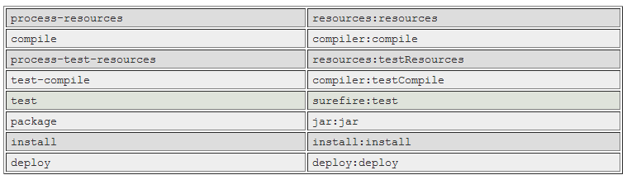
Intro to MAVEN
Build lifecycle
Notes:
KEY
Maven lifecycle
HOW
MVN assumes that you always go through certain steps in a project.
When calling a command, MVN goes through all the steps until (and including) the command we originally called. i.e.: if you call ‘compile’, it will first run ‘process-resources’
TIME
1 min

Slide 15
Backbase MAVEN Repository
Backbase hosts a repository that provides a convenient mechanism to setup a local Maven development environment.
https://repo.backbase.com/repo
Archetypes available from this repository:
Backbase Portal Archetype Blank
Launchpad Archetype
Notes:
KEY
BB repository
HOW
We will use the Backbase repository throughout the exercises
TIME
1 min

Slide 16
JETTY
Jetty is lightweight HTTP server and servlet container
maven-jetty-plugin
Run using command
mvn jetty:run
If you want your data to be reset to initial data then before jetty:run first execute the command:
mvn clean install (blank archetype)
mvn clean –Pclean-database (launchpad archetype)
Notes:
KEY
Jetty server
HOW
Jetty is used as lightweight and convenient http server for development purposes. MVN has a Jetty plugin allowing developers to simply call ‘mvn jetty:run’ to run the portal locally.
In production env, we use other http servers such as IBM Websphere.
When running into issues, you can easily reset to initial data by calling the `clean` profile (see above)
TIME
1 min

Slide 17
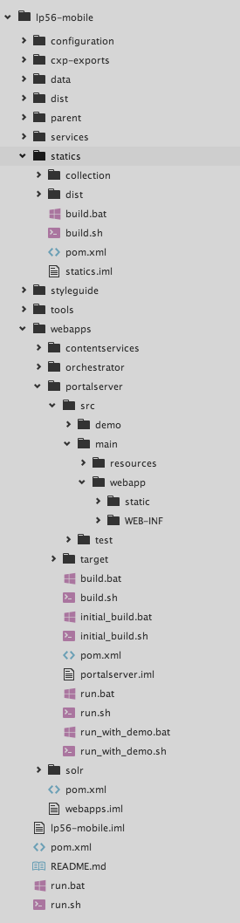
Archetype Project Structure
Highlights
webapps/ : Portal, CS, Solr & Orchestrator
configuration/ : all Backbase-specific configuration
services/ : custom Camel services
statics/ : Launchpad collection & custom items
styleguide/ : documentation of Launchpad Components
Notes:
KEY
Project srtucture
HOW
Describe the various folders.
configuration/ : config files
jetty config : web app folders, db files, etc…
backbase.properties file: config related to CXP platform (most commonly used)
Webapps: portal, CS & Orch are now in here
src/: source files needed for portal dev
src/main/java: all java source files
src/resources: resources important for the project (xml files used by the import tool, ptc config files, spring config files in META-INF subfolder)
src/webapp : static files
src/webapp/static: js , css, etc
src/WEB-INF: jsp files
TIME
3 min

Slide 18
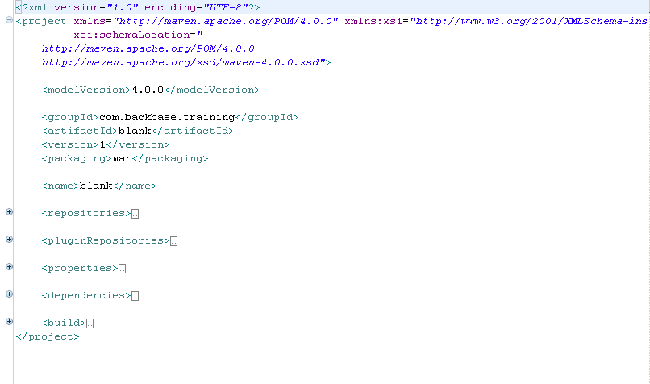
Project Object Model (POM)
Notes:
KEY
POM example
KEY
Provided by the archetype, already configured to access the Backbase artifactory
Open Pom.xml and walk through it, discuss about the DEPENDENCIES in the bb portal pom
Configuration of dependencies, plugins, properties, build cycles, etc…
TIME
1 min

Slide 19
CXP Installation
Installing a CXP Development Environment
Launchpad-based Project
https://my.backbase.com/docs/how-to-guides/article//getting-your-first-launchpad-based-portal-set-up
Widget Collections 2.x Project
https://my.backbase.com/docs/how-to-guides/article//setting-up-cxp-5-6-x-and-widget-collection-2-1-x-from-scratch
Notes:
KEY
Project Installation
HOW
Explain to participants that they will install a CXP development environment. Note that the installation guide will be different, depending on the Widget Collection used. You must guide them to use one or another, never both. Now we have two installation processes: One for Launchpad and other for Widget Collections 2.x
TIME
90 min

Slide 20
Archetype Structure
Portal Technologies

Slide 21
Directories
Configuration: /configuration
Source and test: /src/main, /src/test
Resources and config: /src/main/resources
Spring config: /src/main/resources/META-INF/spring
Portal import scripts: /src/main/resources/import
Java code: /src/main/java
Webapp code: /src/main/webapp
Static files: /src/main/webapp/static
WEB-INF: /src/main/webapp/WEB-INF
Maven build directory: /target
Notes:
KEY
Project directories
HOW
/portalserver/configuration
src/main: source files
src/main/resources/ : resources files such as config files for spring, import files…
TIME
3 min

Slide 22
Files
POM (Project Object Model): /pom.xml
Dependencies
Build
Plugins
Jetty
Web app config: /src/main/webapp/WEB-INF/web.xml
Links to Spring config
Notes:
KEY
Files
HOW
Describe pom.xml
TIME
2 min

Slide 23
Points To Remember
Portal uses a core set of technologies, but can integrate with many more
Maven is a convenient way to run a local Portal development environment

